Slide 1
Gamma thoughts

Slide 2
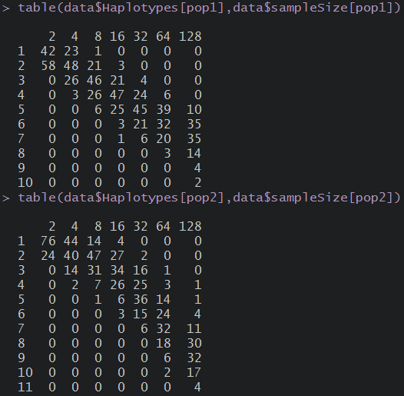
Distribution of number of haplotypes in the simulated samples
Population 1
Theta=2
Growth
Population 2
Theta=2
No Growth

Slide 3
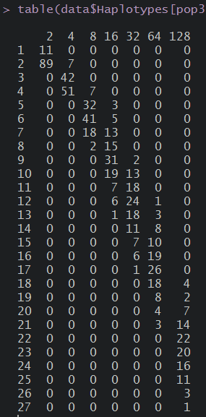
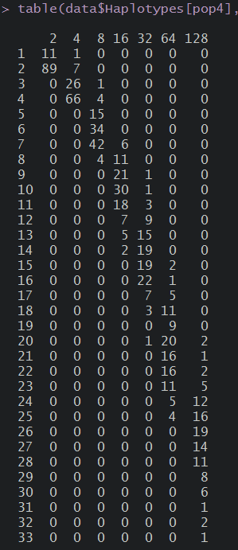
Population 3: Theta=10 Growth
Population 4: Theta=10 No Growth

Slide 6
Population 1

Slide 7
Population 2

Slide 8
Population 3

Slide 9
Population 4

Slide 10
Trying kernels

Slide 11
Here without specifying bandwith

Slide 12
Here I tried to put the haplotype diversity as the band width

Slide 13
Theta and segregating sites
Here some plots to help thinking in the Wakeley method

Slide 14
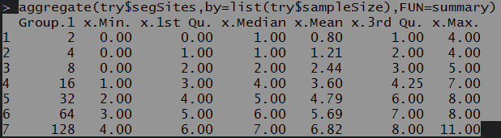
Population 1 (T2g)

Slide 18
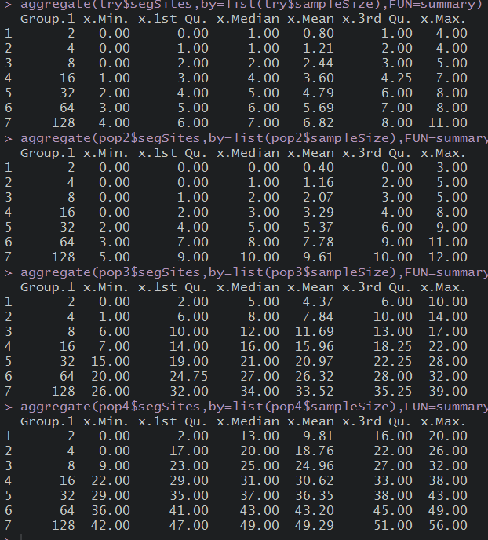

Slide 19
Empirical distributions
Here plots on the empirical distributions of observed values

Slide 20
Violin plots of simulated data
Population 1- theta 2
Population 3- theta 10
n128
n128
n64
n64
n32
n32
n16
n16
n8
n8
n4
n4
n2
n2
2
4
6
8
10
0
5
10
15
20
25
Observed number of haplotypes

Slide 21
Population 1-theta 2
Population 3-theta 10
Observed haplotypes
10
Observed haplotypes
25
8
20
6
15
4
10
2
5
0
n2
n4
n8
n16
n32
n64
n128
n2
n4
n8
n16
n32
n64
n128

